Slide 1
South to North
and Back

Slide 2

Life begins at the end of your comfort zone
-by Neal Donald-
Notes:
What did I do that was not comfortable but helped me grow?
There were many of them,
but at this moment
It was far from perfect. That wasn’t comfortable at all!
I still have a scar on my knee, which will always remind me,
of my small achievement in life. I’m sure everyone has their stories and you are not the exception!

Slide 3


Journey Begin from south………
Studied at Rathnavali girls' college, Gampaha
Got selected to follow a Computer science Degree at University of Jaffna
Relocated to Jaffna as a newbie
Notes:
I was fortunate enough to be selected to the University of Jaffna to follow a Computer Science degree.
That was one of the times I had to leave my comfort zone.

Slide 4

Try
Otherwise
You
Will
never
know
Notes:
But I took that step forward anyway.
Some of the main concerns I had was adjusting to a new environment.
A new area, new people, different lifestyles, different foods.
I was able to quickly adopt to the new environment with help of friends.

Slide 5
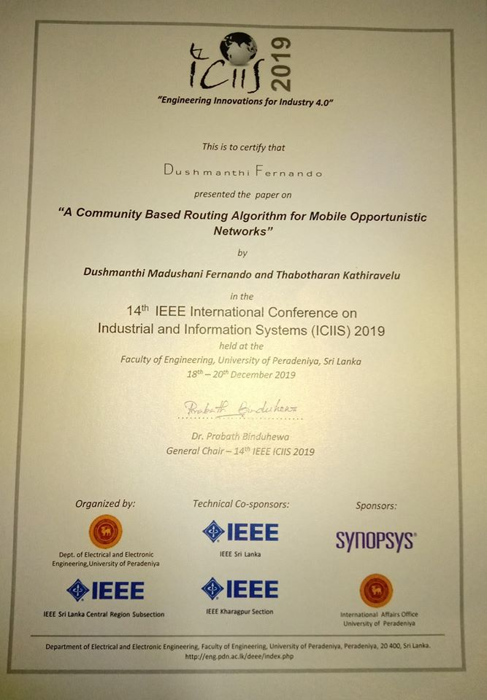
Life as a student at University of Jaffna
Improved communication and presentation skills
Obtained team work
Developed leadership skills and problem solving skills
Published a research paper for IEEE ICIIS conference 2019
Notes:
As an undergraduate I Improved my communication,
I developed teamwork and leadership skills,
problem solving skills by participating in seminar for school students
I published research paper for IEEE ICIIS conference 2019.

Slide 6

Started as Temporary instructor(Demo) at University of Jaffna
Shared our knowledge and experience with students
Developed the ability to deal with different personalities
Got experience by Evaluating students’ assessments
Gain hands on experience on technologies
Notes:
This was after four years of my degree and after four years of departing from my home.
I left my hometown just as a high school pass out and now here I am, a staff at one of the prestigious universities in the country.
It was good opportunity
I got real experience by
I was able to gain hands on experience on technologies such as Java,

Slide 7

Entry to Industry….
Got an opportunity to join the SGIC
Developed Defect Tracker
Adapt to new technologies was upgraded
SGIC course helps bridge the gap between the academic & software industry
Great industrial experience with lots of motivation and mentoring by the professionals in industry
Notes:
While I was getting myself updated with some skills in technologies,
there was this talk among the
how our seniors actively underwent a six months training on an industrial bridging programme and
that most of them got hired by leading companies such as
This got me excited. Not just me, but my fellow staff members were also planning to get enrolled.
I would say my entry into SGIC really made a whole change on my entire thought about IT world.
I became passionate about Software industry and committed myself fully into the training.
This course helps bridge the gap between the academic & software industry.

Slide 8

Back to South
Started the next chapter of my career at a leading global company, VIRTUSA.
Developed the courage to take new roles and responsibilities
Notes:
I never thought I would be learning all these technical skills required for my career in the North.
After spending 5 years in the north, I recently got an opportunity to work as a Software Engineer at a leading global company,
VIRTUSA. This is pure dream for me.
I am ever grateful to SGIC for changing not only my life, but my family as well.
I wish SGIC all the very best and proud and happy to be part of SGIC family.

Slide 9
If I Can Do It, You Can Too!
Notes:
If I can come all the way from south to north moving out of my comfort zone and grab these wonderful opportunities that North offers,
you all should grab this opportunity which is within your arm’s length.

